Slide 1
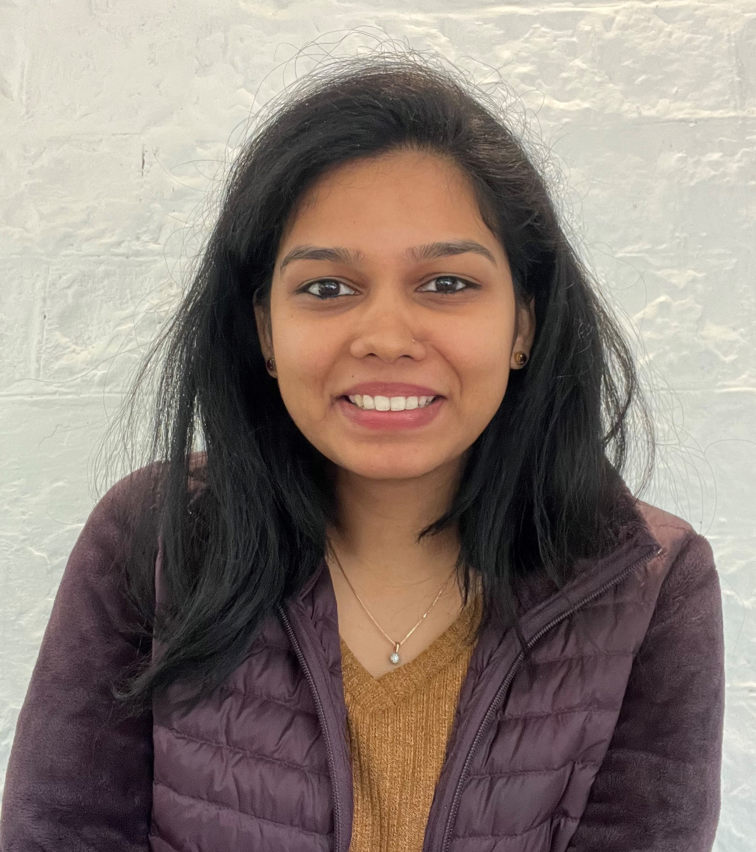
3 years of experience in areas of Market Mix Modelling projects.
Experience working in different sectors such as Gaming, Automobiles, FMCG, and E-commerce across markets
My day-to-day activity includes
Interacting with the Client, understanding their requirements, responsible for the end-to-end delivery of analytics
Extensive hands-on experience in working iExcel, PPT, & Python
Building insights, recommendations, and XXXX. which can help solve key business and impact the business growth positively
Provide client support XXXX
Personal Skills:
XXX.
Kavya Bhat
Consultant
Prior Experience
XXX India Technology Centre
Web Developer
Higher Graduation
Computer science and Engineering graduate
Completed course in Full stack data science from Jigsaw academy

